Slide 1
Pollution documentary
By Naitik

Slide 2
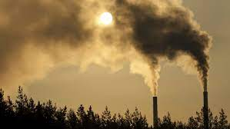
Pollution is the introduction of harmful materials into the environment. These harmful materials are called pollutants. Pollutants can be natural, such as volcanic ash. They can also be created by human activity, such as trash or runoff produced by factories.
WHAT IS POLLUTION

Slide 3
What are facts about pollution
.
Less than 1% of global land area has safe air pollution levels. ...
At least 1 in 10 people die from air pollution-related diseases. ...
Air pollution is a greater threat to life expectancy than smoking, HIV or war. ...
Air pollution has a nearly US$3 trillion economic cost, or 3.3% of the world's GDP.

Slide 4
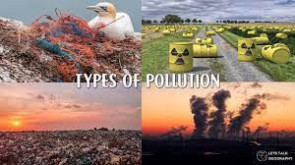
What are the 7 main types of pollution
Air Pollution.
Water Pollution.
Soil Pollution.
Thermal Pollution.
Radioactive Pollution.
Noise Pollution.
Light Pollution.

Slide 5
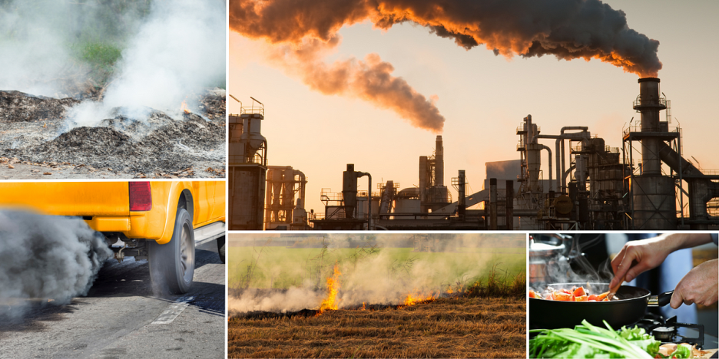
Air Pollution
Vehicle emissions, fuel oils and natural gas to heat homes, by-products of manufacturing and power generation, particularly coal-fueled power plants, and fumes from chemical production are the primary sources of human-made air pollution.

Slide 6
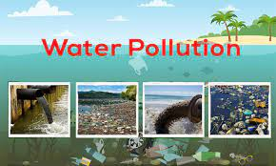
Water Pollution
The main water pollutants include bacteria, viruses, parasites, fertilisers, pesticides, pharmaceutical products, nitrates, phosphates, plastics, faecal waste and even radioactive substances. These substances do not always change the colour of the water, meaning that they are often invisible pollutants.

Slide 7
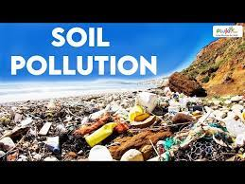
Soil Pollution
Soil pollution refers to the contamination of soil with anomalous concentrations of toxic substances. It is a serious environmental concern since it harbours many health hazards. For example, exposure to soil containing high concentrations of benzene increases the risk of contracting leukaemia.

Slide 8
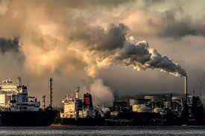
Thermal Pollution
Thermal pollution is a rapid change in temperature in a natural body of water. This pollution is most often caused by heated discharge from an industrial facility or another human activity. Thermal pollution can result in disruptions in natural systems and stress, disease, or even death for affected organisms.

Slide 9
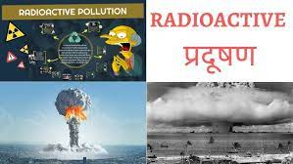
Radioactive pollution
Radioactive pollution is caused by the unmitigated release of radioactive elements and waste into the land, water, air, or nearby living organisms. These radioactive materials then release ionizing radiation which pollutes and contaminates its surroundings.

Slide 10

Noise Pollution
Vehicle emissions, fuel oils and natural gas to heat homes, by-products of manufacturing and power generation, particularly coal-fueled power plants, and fumes from chemical production are the primary sources of human-made air pollution.

Slide 11
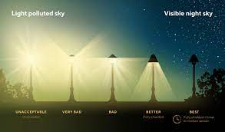
Light pollution
The primary cause of light pollution is outdoor lights that emit light upwards or sideways. Any light that escapes upward, except where a tree or building may be blocking it, will scatter throughout the atmosphere and brighten the night sky, thereby diminishing the view of it.

